Slide 1
Application Layer
Lecture 40
Department of Computer Science and Engineering
Chitkara University, Punjab
1
Notes:
1

Slide 2
Contents
Application Layer
DNS
Electronic Mail
Remote Logging
Dr. Gaganpreet Kaur
2
Notes:
2

Slide 3
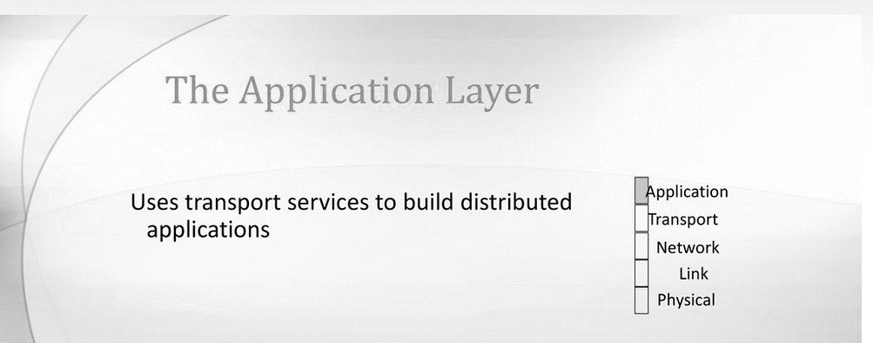
Application Layer
Application Layer:
The application layer sits at Layer 7, the top of the Open Systems Interconnection (OSI) communications model. It ensures an application can effectively communicate with other applications on different computer systems and networks.
The application layer is not an application. Instead, it is a component within an application that controls the communication method to other devices. It is an abstraction layer service that masks the rest of the application from the transmission process.
3
Notes:
3

Slide 4
DNS: Domain Name Server
DNS is a hostname for IP address translation service. DNS is a distributed database implemented in a hierarchy of name servers. It is an application layer protocol for message exchange between clients and servers.
NEED OF DNS:
Every host is identified by the IP address but remembering numbers is very difficult for the people also the IP addresses are not static therefore a mapping is required to change the domain name to the IP address. So DNS is used to convert the domain name of the websites to their numerical IP address.
4
Notes:
4

Slide 5
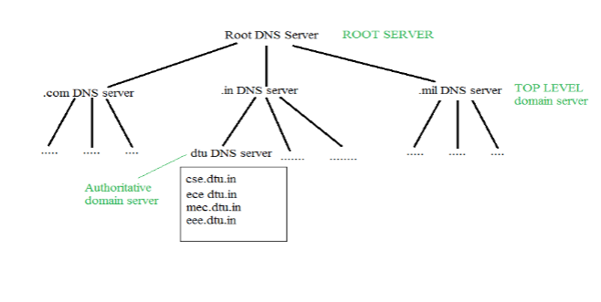
DNS: Domain Name Server
Different Kind of Domains:-
Generic domain: .com (commercial) .edu (educational) .mil (military) .org (non profit organization) .net (similar to commercial) all these are generic domain.
Country domain: .in (india) .us .uk
Inverse domain: if we want to know what is the domain name of the website. Ip to domain name mapping.
Organization of Domain:
Figure 1: Organization of Domain
5
Notes:
5

Slide 6
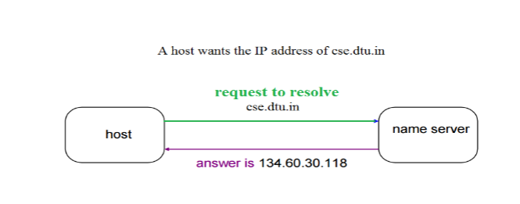
DOMAIN NAME SERVER NAME TO ADDRESS RESOLUTION
The host requests the DNS name server to resolve the domain name. And the name server returns the IP address corresponding to that domain name to the host so that the host can future connect to that IP address.
Hierarchy of Name Servers Root name servers: It is contacted by name servers that can not resolve the name. It contacts authoritative name server if name mapping is not known. It then gets the mapping and returns the IP address to the host.
Top level domain (TLD) server: It is responsible for com, org, edu etc and all top level country domains like uk, fr, ca, in etc. They have info about authoritative domain servers and know the names and IP addresses of each authoritative name server for the second-level domains.
Authoritative name servers are the organization’s DNS server, providing authoritative hostName to IP mapping for organization servers. It can be maintained by an organization or service provider. In order to reach cse.dtu.in we have to ask the root DNS server, then it will point out to the top level domain server and then to authoritative domain name server which actually contains the IP address. So the authoritative domain server will return the associative ip address.
6
Notes:
6

Slide 7
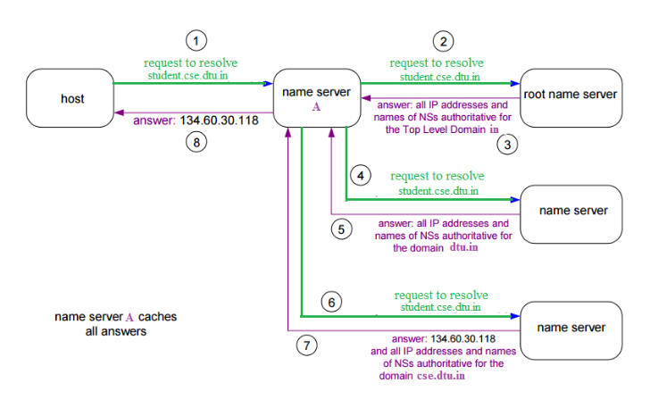
DOMAIN NAME SERVER: WORKING
The client machine sends a request to the local name server, which , if root does not find the address in its database, sends a request to the root name server , which in turn, will route the query to an top-level domain (TLD) or authoritative name server.
The root name server can also contain some hostName to IP address mappings. The Top-level domain (TLD) server always knows who the authoritative name server is.
So finally the IP address is returned to the local name server which in turn returns the IP address to the host.
Figure 2: DNS WORKING

Slide 8
Electronic Mail
Electronic Mail (e-mail) is one of most widely used services of Internet. This service allows an Internet user to send a message in formatted manner (mail) to the other Internet user in any part of world. Message in mail not only contain text, but it also contains images, audio and videos data. The person who is sending mail is called sender and person who receives mail is called recipient. It is just like postal mail service.
Components of E-Mail System :
The basic components of an email system are :
User Agent (UA), Message Transfer Agent (MTA), Mail Box, and Spool file.
These are explained as following below:
User Agent (UA) : The UA is normally a program which is used to send and receive mail. Sometimes, it is called as mail reader. It accepts variety of commands for composing, receiving and replying to messages as well as for manipulation of the mailboxes.
Message Transfer Agent (MTA) : MTA is actually responsible for transfer of mail from one system to another. To send a mail, a system must have client MTA and system MTA. It transfer mail to mailboxes of recipients if they are connected in the same machine. It delivers mail to peer MTA if destination mailbox is in another machine. The delivery from one MTA to another MTA is done by Simple Mail Transfer Protocol.

Slide 9
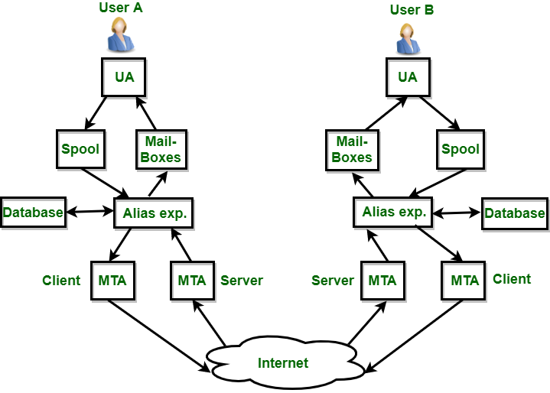
Electronic Mail
3. Mailbox : It is a file on local hard drive to collect mails.
Delivered mails are present in this file. The user can read it delete it according to his/her requirement.
To use e-mail system each user must have a mailbox . Access to mailbox is only to owner of mailbox.
4. Spool file : This file contains mails that are to be sent.
User agent appends outgoing mails in this file using SMTP.
MTA extracts pending mail from spool file for their delivery.
E-mail allows one name, an alias, to represent several different e-mail addresses.
It is known as mailing list, Whenever user have to sent a message, system checks recipient’s name against alias database.
If mailing list is present for defined alias, separate messages, one for each entry in the list, must be prepared and handed to MTA. If for defined alias, there is no such mailing list is present, name itself becomes naming address and a single message is delivered to mail transfer entity.

Slide 10
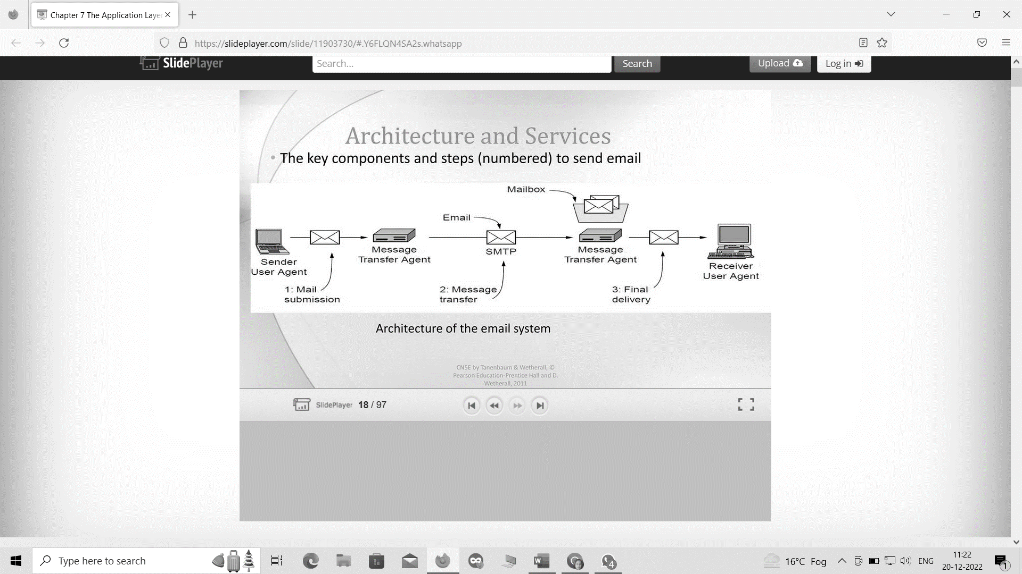
ARCHITECTURE OF EMAIL SYSTEM:
Figure 3 : Architecture of Email System

Slide 11
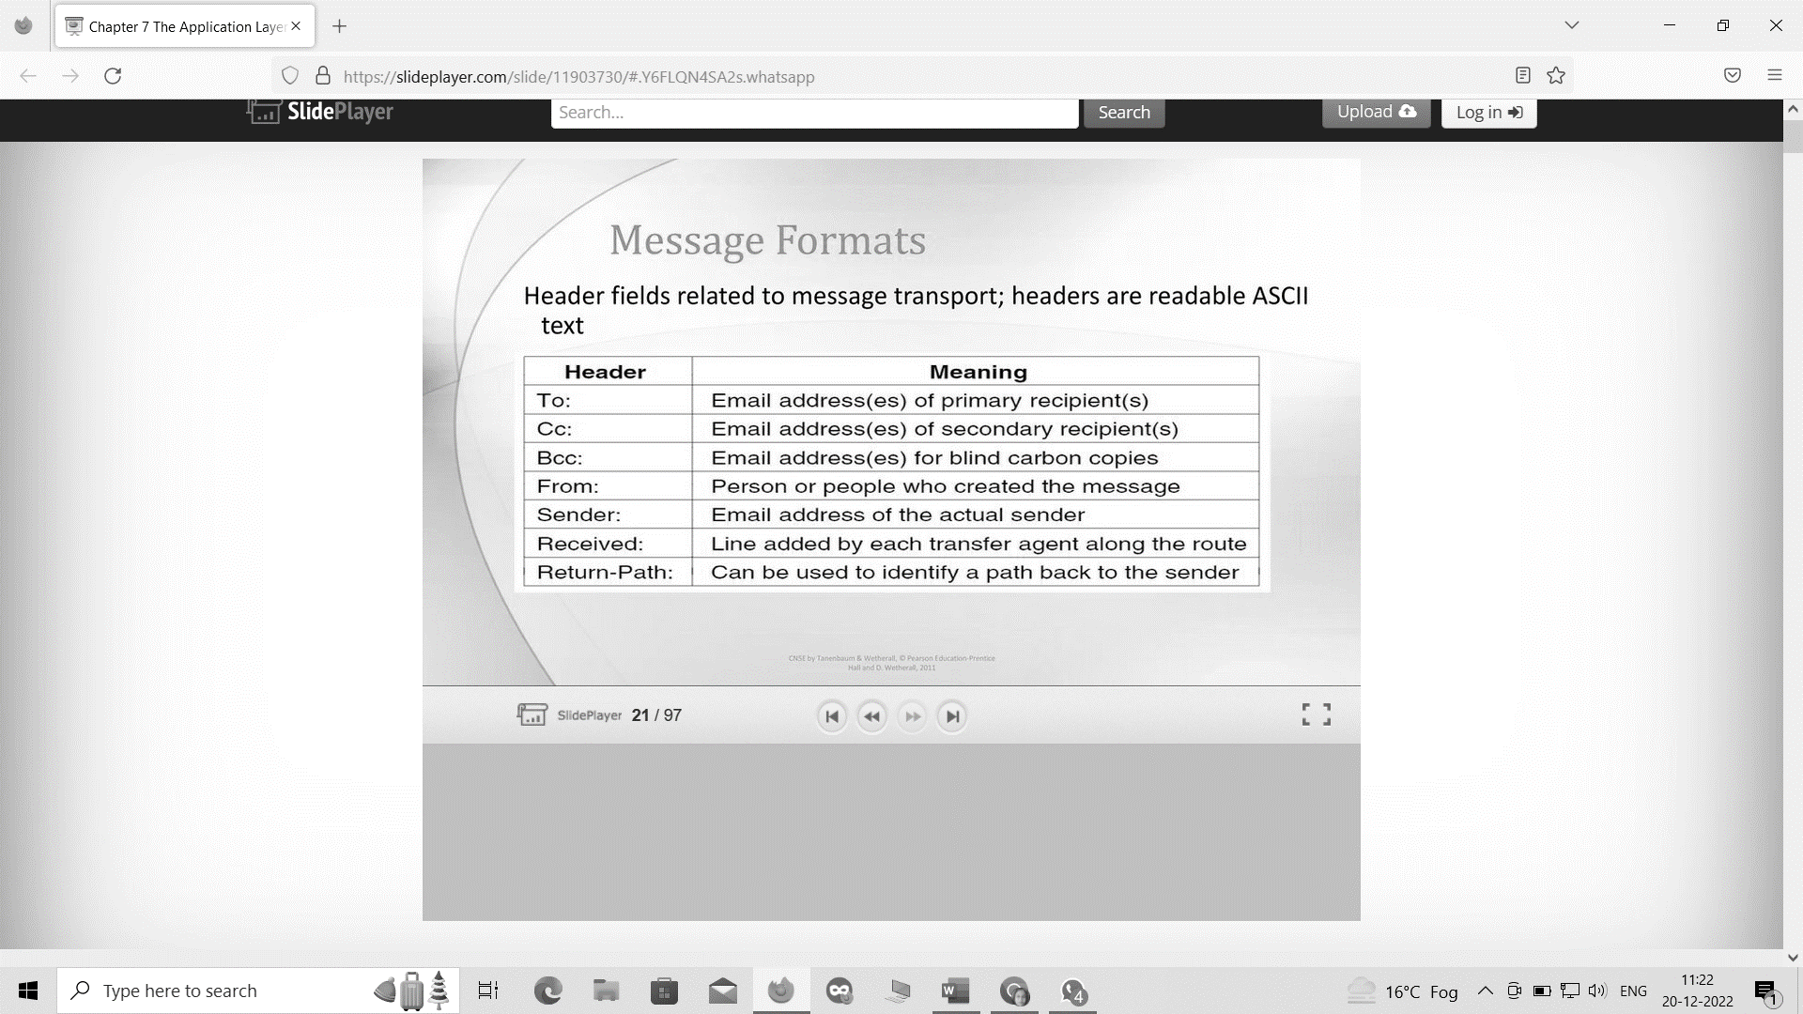
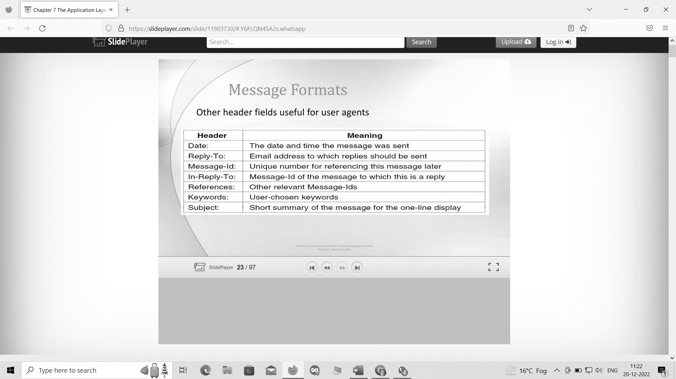
MESSAGE FORMATS
Figure 4 : Message Formats of Email System

Slide 12
Telnet
The main task of the internet is to provide services to users. For example, users want to run different application programs at the remote site and transfers a result to the local site. This requires a client-server program such as FTP, SMTP. But this would not allow us to create a specific program for each demand.
Telnet provides a connection to the remote computer in such a way that a local terminal appears to be at the remote side.

Slide 13
How remote login occurs ?
At the local site
The user sends the keystrokes to the terminal driver, the characters are then sent to the TELNET client. The TELNET client which in turn, transforms the characters to a universal character set known as network virtual terminal characters and delivers them to the local TCP/IP stack
At the remote site
The commands in NVT forms are transmitted to the TCP/IP at the remote machine. Here, the characters are delivered to the operating system and then pass to the TELNET server. The TELNET server transforms the characters which can be understandable by a remote computer.
However, the characters cannot be directly passed to the operating system as a remote operating system does not receive the characters from the TELNET server. Therefore it requires some piece of software that can accept the characters from the TELNET server.
The operating system then passes these characters to the appropriate application program.

Slide 14
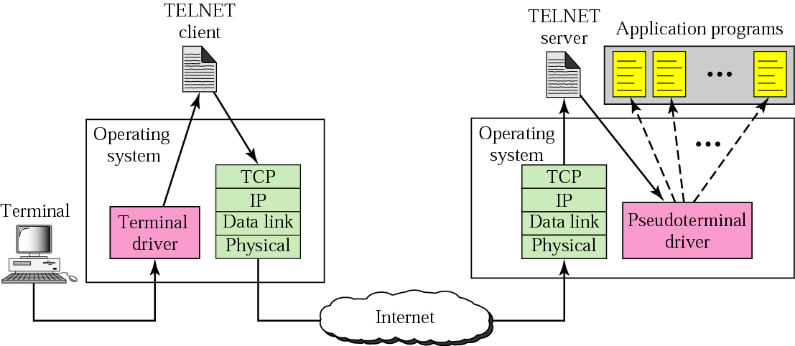
Telnet
Figure 5 : Remote Login in Telnet

Slide 15
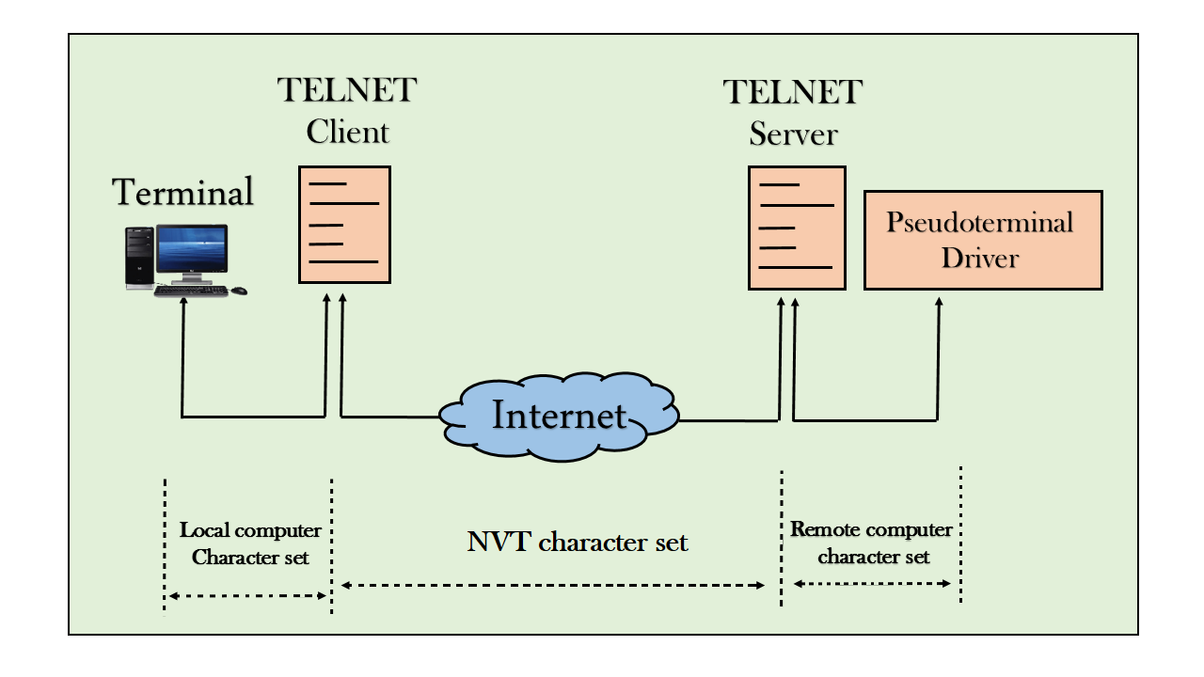
Network Virtual Terminal (NVT)
The network virtual terminal is an interface that defines how data and commands are sent across the network.
TELNET solves this issue by defining a universal interface known as network virtual interface.
The TELNET client translates the characters that come from the local terminal into NVT form and then delivers them to the network. The Telnet server then translates the data from NVT form into a form which can be understandable by a remote computer.
Figure 6 : NVT

Slide 16
THANK YOU

